Slide 1
Facebook User Behavior Analytics
7200 Big-Data Sys Engr Using Scala
Chenxi Hu & Nan Yang
Spring 2016

Slide 2

Methodology
Data Collection
Data Analysis
Data Usage - multiuser accounts
Fetch Data from Posts
Fetch Data from Likes
Determine topics based on posts (TF-IDF)
Create user relationship graph with depth of 3 based on Likes
Calculate topic similarity and overlap of Likes graph
Group similar users
Data for Analysis
Start from a specific user
User recommendation for specific user id and search associative users given a key word

Slide 3
Data sources
Fetching timeline data of users from facebook
Whole timeline facebook posts is saved as a single text document

Slide 4

Tools involved
Facebook Developer
Graph Analytics tools (Neo4j)
Spark Mlib
Spark
Akka Actor
Play Framework

Slide 5
TF IDF
Term frequency and inverse document frequency
tf = single word frequency in a document / frequency of word with most occurrence
idf = Log(numbers of documents / numbers of documents containing the given word)
Tf-idf = tf * idf

Slide 6
Training a TF-IDF model
HashingTF transform each tokenized document into vector representation, map hash value of each token to vector of term frequency.
Train a NaiveBayes Model to predict the group a given user belongs to.

Slide 7
Training a TF-IDF model
Recommend users for a given user by calculating similarity between vector representation of users.
cosineSimi = SparseVector_A.dot(SparseVector_B) / norm(SparseVector_A) * norm(SparseVector_B)

Slide 8
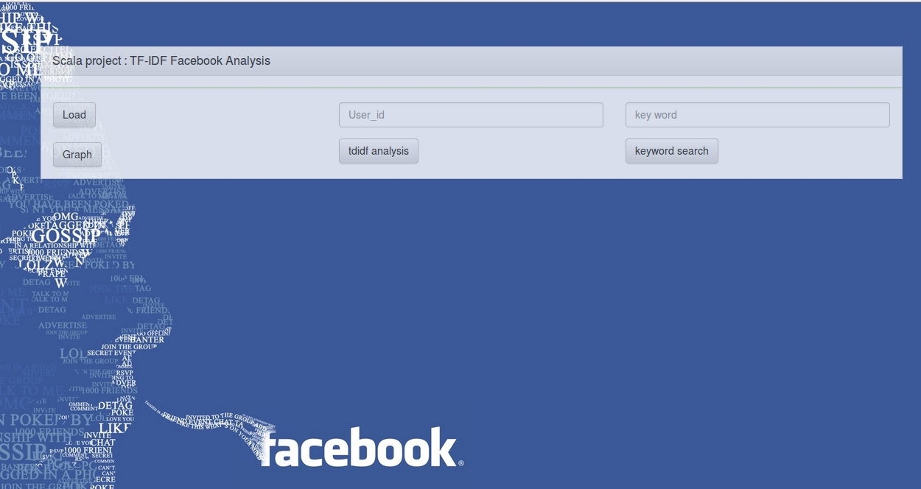
UI design

Slide 9
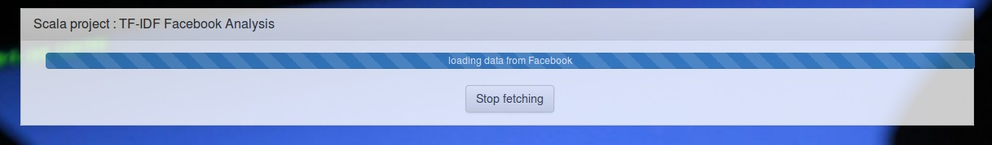
Data fetching

Slide 10
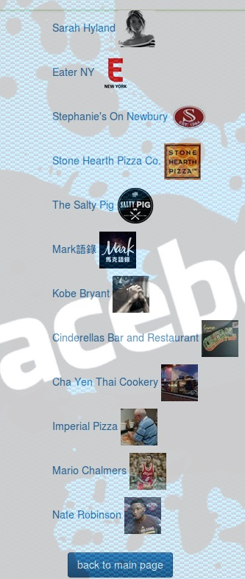
Recommend users given user id

Slide 11
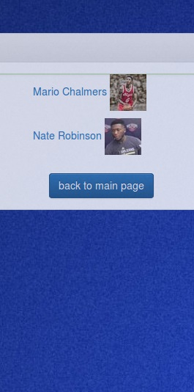
Search users based on keyword

Slide 12
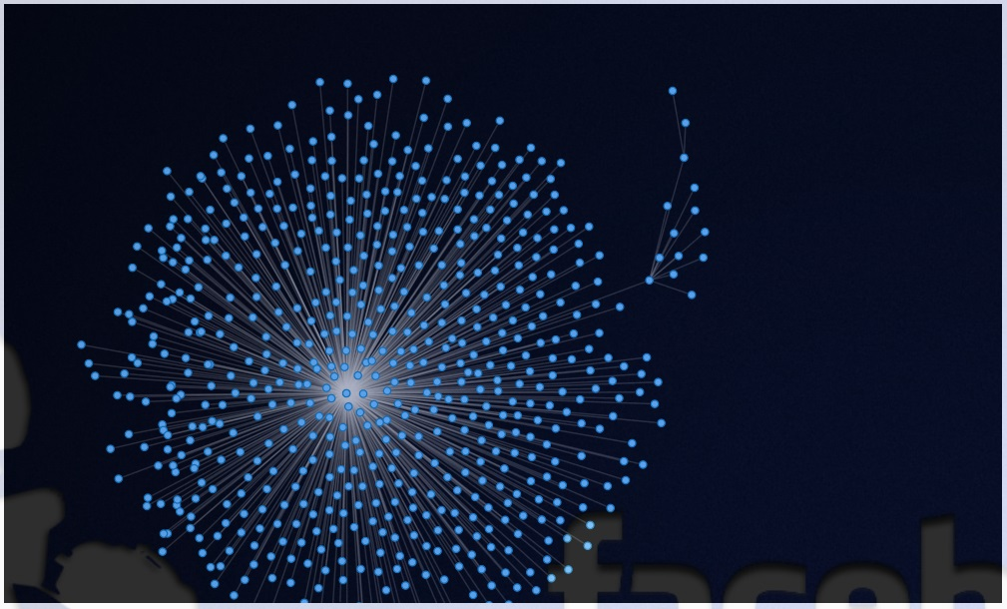
Graph Visualization

Slide 13
Thank you
for any advice and suggestion.

